Slide 1
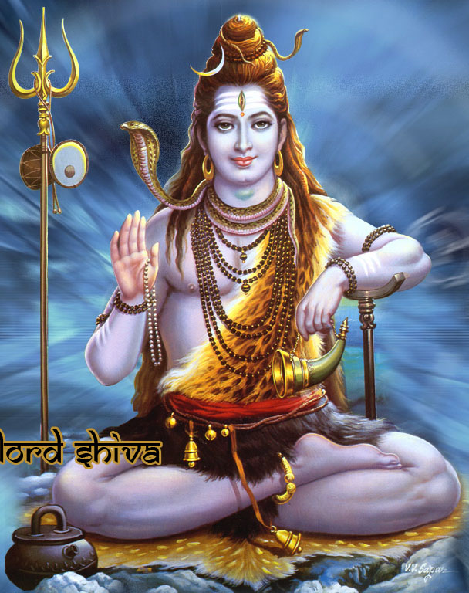
Maha Shivratri

Slide 2
Maha Shivratri
Maha Shivratri (Great Night of Shiva or Night of Shiva) is a Hindu festival celebrated every year on the 13th night/14th day in the Krishna Paksha (waning moon) of the month of Phalguna in the Hindu calendar (that is, the night before and day of the new moon).
Shiva means auspicious
Lord Shiva continuously dissolves the universe to recreate in the cyclic process of creation, preservation, dissolution and recreation of the universe.
Lord Shiva is the Lord of mercy and compassion. He protects devotees from evil forces such as lust, greed, and anger. He grants boons, bestows grace and awakens wisdom in His devotees.

Slide 3
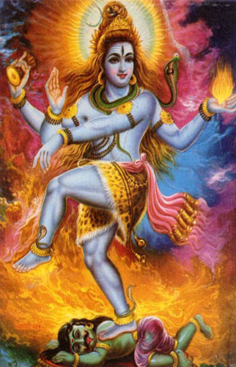
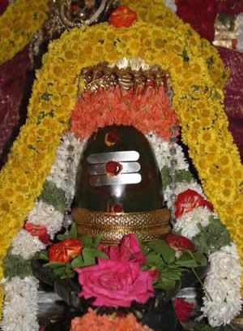
Why we celebrate Maha Shivratri
Various Legends
Shivaratri marks the wedding day of Lord Shiva and Parvati.
On the auspicious night of Shivaratri that Lord Shiva performed the ‘Tandava’, the dance of the primal creation, preservation and destruction.
Story goes that after creation was complete, Lord Shiva began to live on top of the mount Kailash with his consort Parvati. One day, Goddess Parvati asked Shiva that his devotees perform many rituals to please the Lord, but which one pleases him most. To this, Lord Shiva replied that the 14th night of the new moon, during the month of Phalgun is his favorite day. The day is celebrated as Shivaratri
Another popular Shivratri legend stated in Linga Purana states that it was on Shivaratri that Lord Shiva manifested himself in the form of a Linga. Hence the day is considered to be extremely auspicious by Shiva devotees and they celebrate it as Mahashivaratri - the grand night of Shiva.

Slide 4
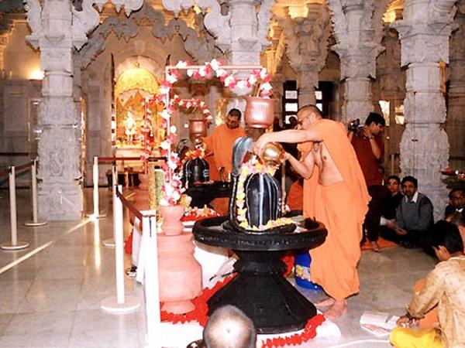
How do we celebrate Shivratri
People performing abhishek of Shiva Linga with six different dravyas including milk, yoghurt, honey, ghee, sugar and water while chanting Sri Rudram, Chamakam and Dasa Shanthi
According to the mythology, each of these dravya used in the abhisheka blesses a unique quality:
Milk is for the blessing of purity and piousness.
Yogurt is for prosperity and progeny.
Honey is for sweet speech.
Ghee is for victory.
Sugar is for happiness.
Water is for purity.
People offer Bael leaves to Lord Shiva
People Fast the whole day and stay awake on the night (Jagran)
People do meditation and chant Om Namah Shivaaya

Slide 5
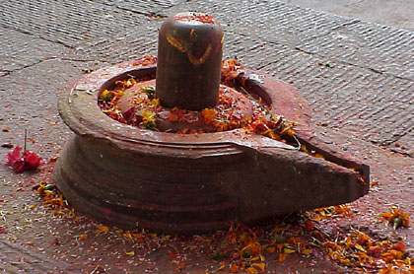
Why Shiva is worshipped in the form of Shiva Lingam
According to another legend, once Brahma and Vishnu, two other deities of the holy Trinity, had an argument as to their supremacy. Brahma being the Creator declared himself to be more revered, while Vishnu, the Preserver, pronounced that he commanded more respect.
Just then a colossal 'lingam', known as Jyotirlinga, blanketed in flames, appeared before them. Both Brahma and Vishnu were awestruck by its rapidly increasing size. They forgot their quarrel and decided to determine its size. Vishnu assuming the form of a boar went to the netherworld and Brahma as a swan flew to the skies. But both of them failed to accomplish the self-assumed tasks. Then, Shiva appeared out of the 'lingam' and stated that he was the progenitor of them both and that henceforth he should be worshiped in his phallic form, the 'lingam', and not in his anthropomorphic form.

Slide 6
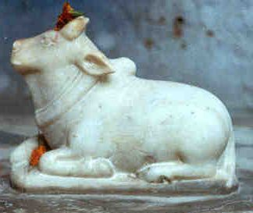
Lord Shiva’s Favorite Vehicle- Nandi
Nandi: the bull is associated with Shiva and is said to be His vehicle. The bull symbolizes both power and ignorance. Lord Shiva's use of the bull as a vehicle conveys the idea that He removes ignorance and bestows power of wisdom on His devotees. The bull is called Vrisha in Sanskrit. Vrisha also means dharma (righteousness). Thus a bull shown next to Shiva also indicates that He is the etemal companion of righteousness.

Slide 7
Lord Shiva- an ascetic
River Ganga
Trishul
Third eye
Snake around his neck
Blue Throat
Dhamru
Rudraksha Mala

Slide 8
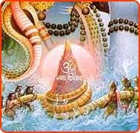
Legend 1 : Blue throat
Blue Throat
Haalaa-Hala - the Poison
During the Sagar Manthan by the gods and demons, haalaa-hala, a pot of poison also came out of the ocean. This terrified the Gods and demons as the poison was so toxic that it effects would have wiped out the entire creation. On the advice of Lord Vishnu, Gods approached Lord Shiva for help and protection as only he could swallow it without being affected. On the request of gods and out of compassion for living beings, Lord Shiva drank the poison. However, Parvati - Lord Shiva’s consort pressed his neck so that the poison does not reach his stomach. Thus, it stayed in his throat neither going up nor going down and Shiva remained unharmed. The poison was so potent that it changed the color of Lord Mahadeva’s neck to blue. For this reason, Lord Shiva is also called Neelakantha (the blue-necked one) where ‘Neela’ means blue and ‘Kantha’ means neck or throat.
As part of the therapy, doctors advised gods to keep Lord Shiva awake during the night. Thus, Gods kept a vigil in contemplation of Lord Shiva. To amuse Shiva and to keep him awake, the gods took turn performing various dances and playing music. As the day broke out, Lord Shiva, pleased with their devotion blessed them all. Shivaratri is the celebration of this event by which Shiva saved the world. Since then, on this day and night - devotees fast, keep vigil, sing glories of Lord and meditate.

Slide 9
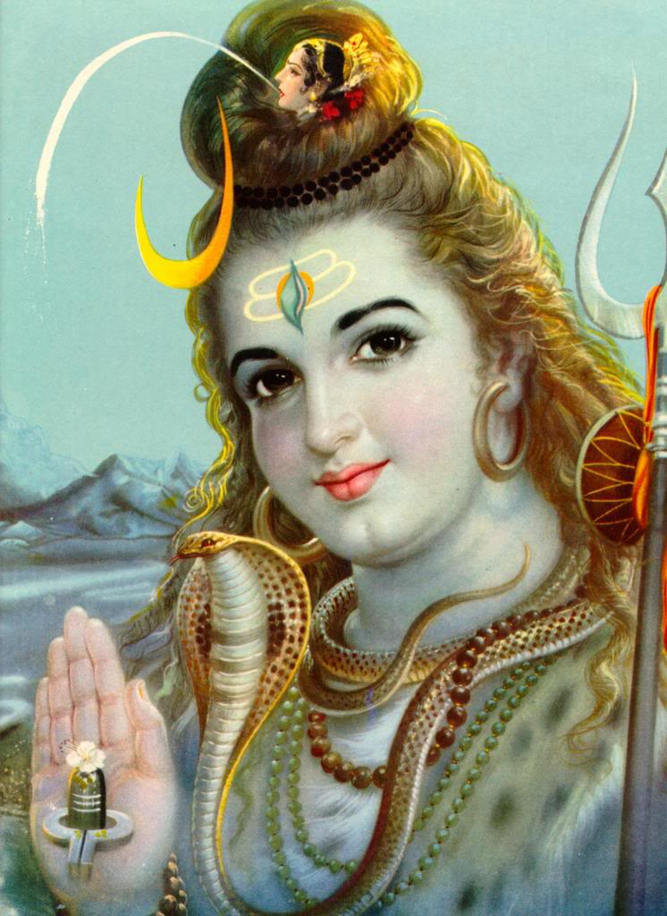
Legend 2 : Mother Ganges comes to Earth
Mother Ganges
Once King Sagar - the ruler of Ayodhya and an ancestor of Lord Rama successfully performed the Ashwamedha Yagya for 99 times. Each time, he sent the horse around the earth it returned to the kingdom unchallenged. However, Indra - the King of God’s became jealous of King Sagar’s success. So when King Sagar performed the sacrifice of the 100th time, Indra kidnapped and hid the Yagya horse in the hermitage of Kapila Muni . In search of the horse, sixty thousand princes from Ayodhya reached Kapil Muni’s hermitage. They mistook the sage to be the abductor and attacked him. An enraged Kapila Muni burnt the 60,000 princes to ashes. On hearing about the plight of his father and uncles, King Bhagiratha - one of the grandchildren of King Sagar requested Kapila Muni to grant a solution to the problem. Kapila Muni advised that the waters of the river Ganga would miraculously bring back the dead princes to life.
King Bhagirath left his kingdom and began to mediate for the salvation of the souls of his ancestors. It is said that Bhagirath observed a penance to Brahma for a thousand years, requesting Ganga to come down to earth from heaven and wash over his ancestor's ashes to release them from a curse and allow them to go to heaven. Pleased with the devotion, Brahma granted Bhagirath’s wish but told him to pray to Lord Shiva, as he alone could sustain the weight of her descent. Accordingly, Lord Shiva held out his thick matted hair to catch the river as she descended. The meandering through Shiva’s lock softened Ganga’s journey to the earth and the holy waters of river Ganga thus washed away the ashes of Bhagirath’s ancestors. A modified version of the legend says, what reached the earth were just sprinkles from Lord Shiva’s hair. The Ganga, thus, became an attribute of Shiva. This manifestation of Shiva is known as Gangadhara.

Slide 10
Lord Shiva’s Third Eye
Third eye
Three eyes: Lord Shiva, also called Tryambaka Deva (literally, "three-eyed Lord"), is depicted as having three eyes: the sun is His right eye, the moon the left eye and fire the third eye. The two eyes on the right and left indicate His activity in the physical world. The third eye in the center of the forehead symbolizes spiritual knowledge and power, and is thus called the eye of wisdom or knowledge. Like fire, the powerful gaze of Shiva's third eye annihilates evil, and thus the evil-doers fear His third eye.

Slide 11
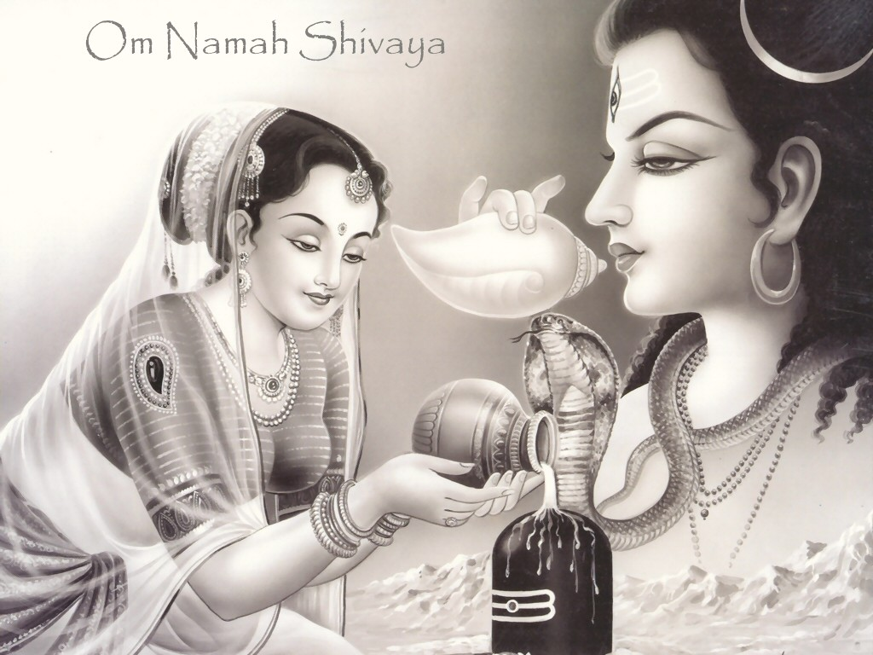
Om Namah Shivaya

